Slide 1
Njmat Tutorial

Slide 2
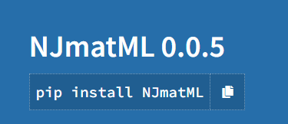
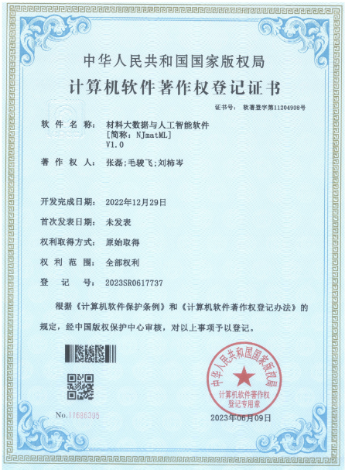
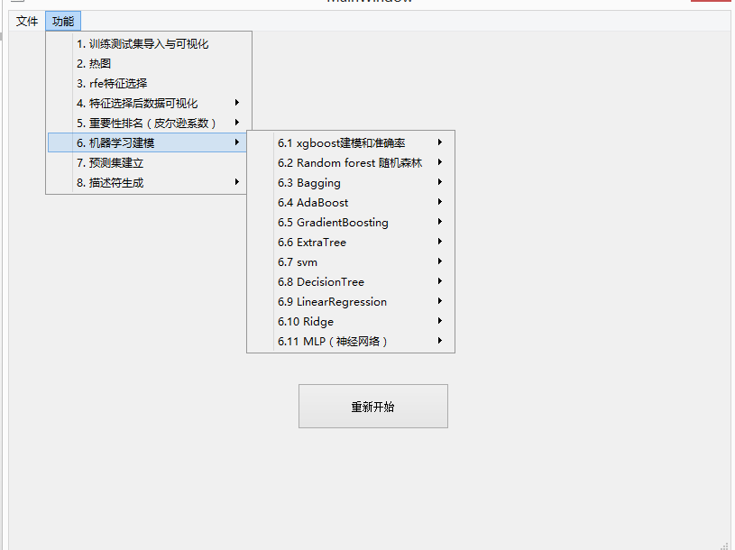
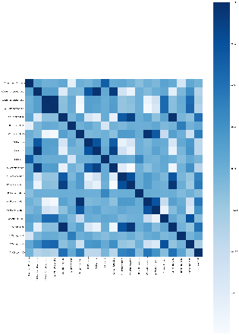
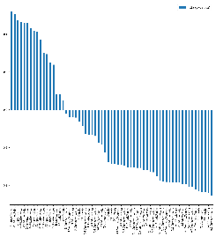
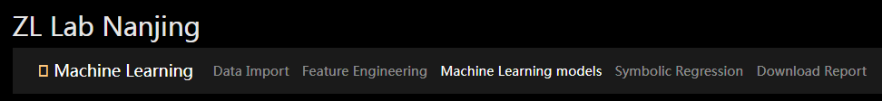
NJmatML: Machine learning software
pip install NJmatML
https://pypi.org/project/NJmatML/
publicly available
User-friendly
Function：data import and visualization/ learning modeling, feature generation (organic and inorganic), feature analysis (importance ranking), feature selection, accuracy calculation, genetic algorithms, prediction, SHAP analysis, etc.
Instructions：https://github.com/Zhang-NJ-Lab/NJmatML/blob/main/2022-11-21/NJmatML-2022-11-21.ipynbynb
Python version
Windows version
NJmatML windows version
下载地址: https://figshare.com/articles/software/NJmatML/24607893
doi: https://doi.org/10.6084/m9.figshare.24607893.v1.exe
Web version
Web version, machine learning model construction, demo
https://patrick007.shinyapps.io/zllab_ofi_ml/
publicly available
NJmatML
Experimental data（csv） Material prediction and validation

Slide 3
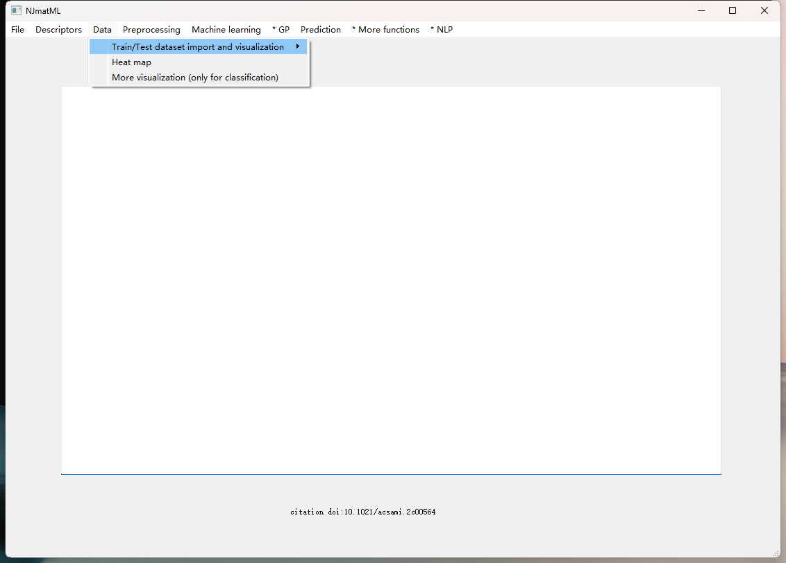
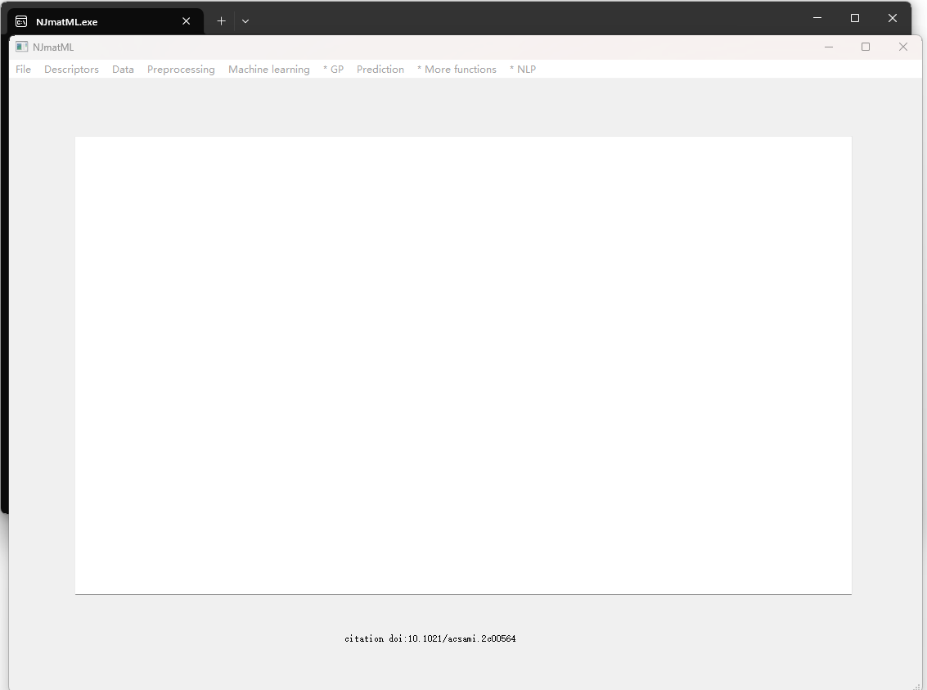
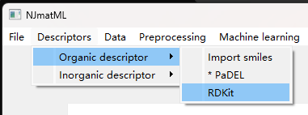
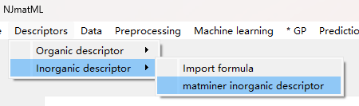
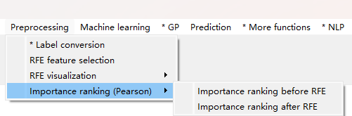
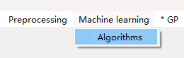
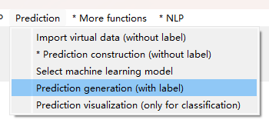
NJmatML: Machine learning software
Dataset import
NJmatML mainwindoe
Button clicking
Organic(RDKit) Inorganic（Matminer ）
Feature generation：
Feature selection
Data generation(csv、figure）
Random forest/XGBoost/Neural network/Adaboost, etc.
Regression/classfication
Genetic/Shapley
Adjustable parameters
Machine learning
model
Visual space
prediction

Slide 4
1.Select the save path

Slide 5
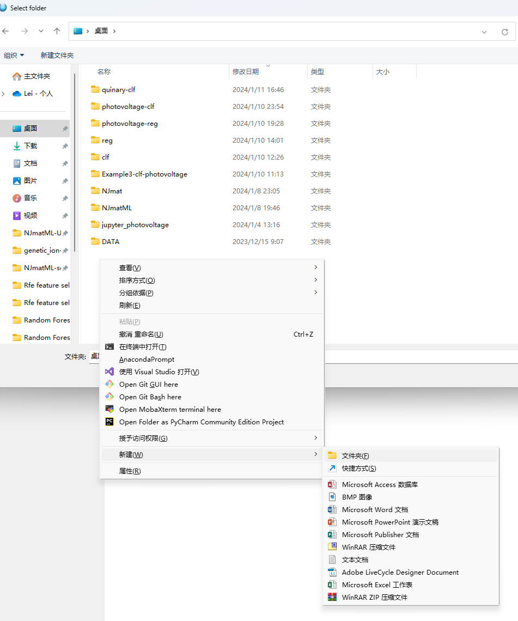
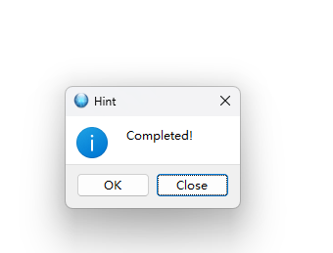
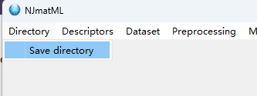
1.Select Project Storage Folder (Custom)

Slide 6
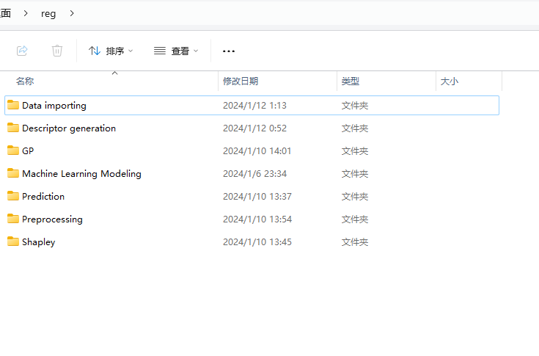
1. Select Project Storage Folder (Custom)
Data import
Feature generation
Genetic algorithm
Machine learning model (regression and classification)
Visual space prediction
Data processing (Feature selection, etc.)
Shapley analysis
New data folder generated in the custom folder

Slide 7
2 Dataset Featurizer

Slide 8
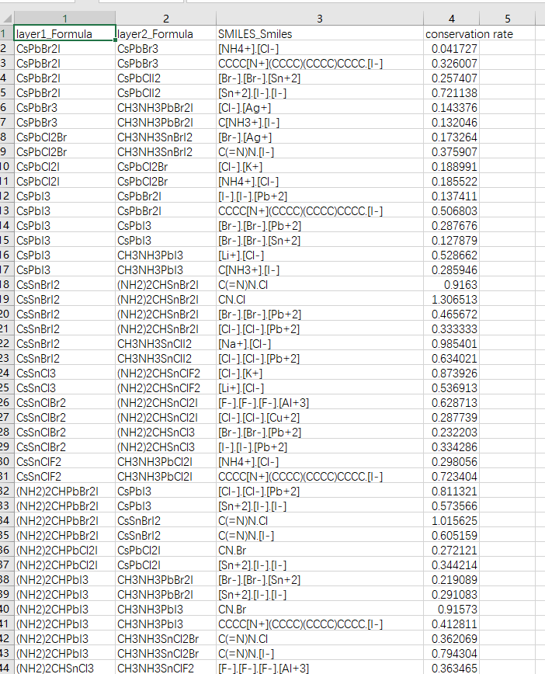
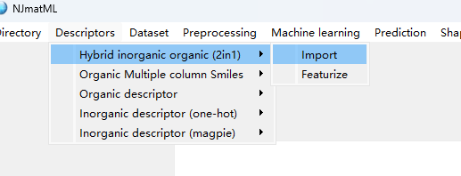
2.1 Featurizer, Button for feature generation（oraganic and inorganic）
2in1:Oragnaic and inorganic
Input: Dataset including formula and smile codes.
Button for featurization (Test and train dataset generation)
Rdkit/matminer(HOMO/LUMO/Atomic property)
Descriptors: Hybrid inorganic organic (2in1) → Import → Featurize
Import raw
Featurize
Original dataset: including formula and smile codes
(csv: UTF-8)

Slide 9
Raw dataset
CSV template
输入变量
输出目标
Inorganic:column name ending with Formula
Organic: column name ending with Smiles
Detail:
Formula: column name ending with Formula
Smiles: column name ending with Smiles
Last column: Target
Other columns : Formula, Smiles and other experimental varible.
Subsequent process:
Njmat--Automatic modeling and forecasting

Slide 10
Formula Formula Smiles T, t, C Output
Variables: for example：
First column：formula
Second column：formula
Third column：Smiles
….
Attention!
Column name ending with Formula
Column name ending with Smiles
Other columns: experimental variables (time/temperature or anything else you're interested in ).
The last column: your target
Target:
Stability/
时间、温度、浓度
variable1
Need
featurization
variable3
Need
featurization
Layer 3 Smiles
Layer 2 Formula
variable2
Need
featurization
Other
experimental
variables
Layer 1 Formula

Slide 11
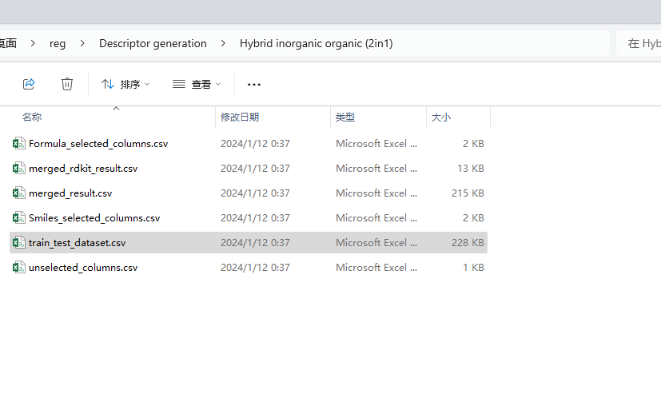
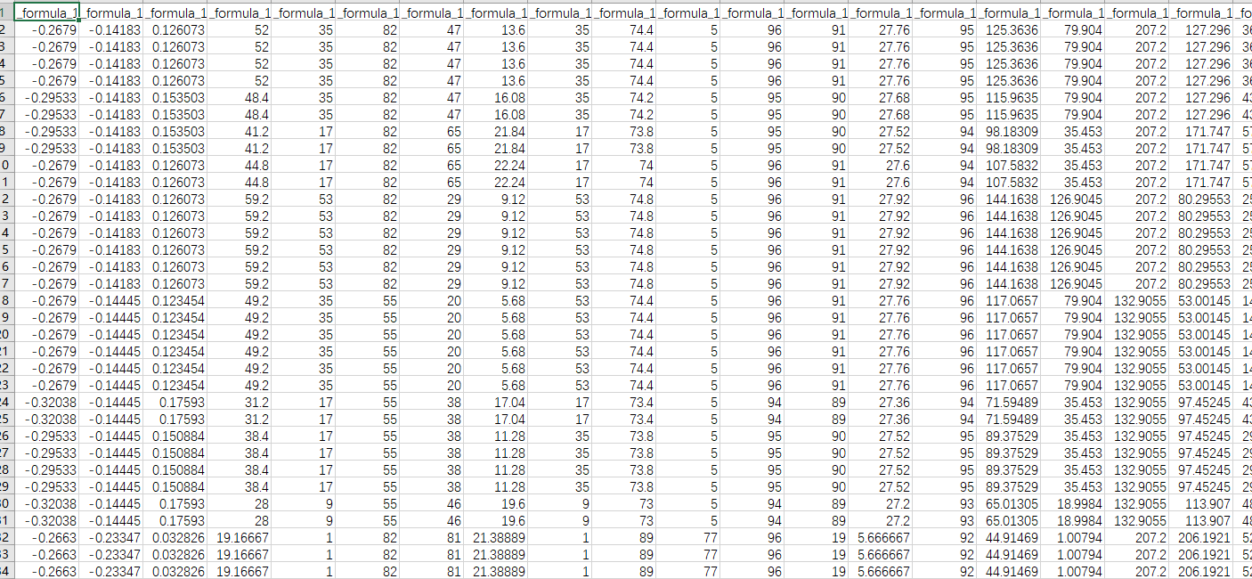
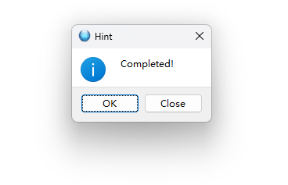
NJmatML: Organic-inorganic featurization（2in1）
train/test dataset after feature generation save path:
Custom folders→Descriptor generation →Hybrid inorganic organic (2in1) →train_test_dataset.csv
Formula：Matminer magpie descriptor
Smiles：RDKit descriptors
Automatically feature
generation
Dataset for feature selection
train_test_dataset.csv

Slide 12
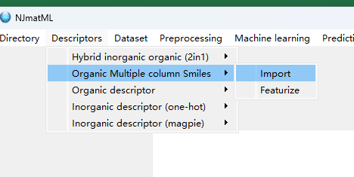
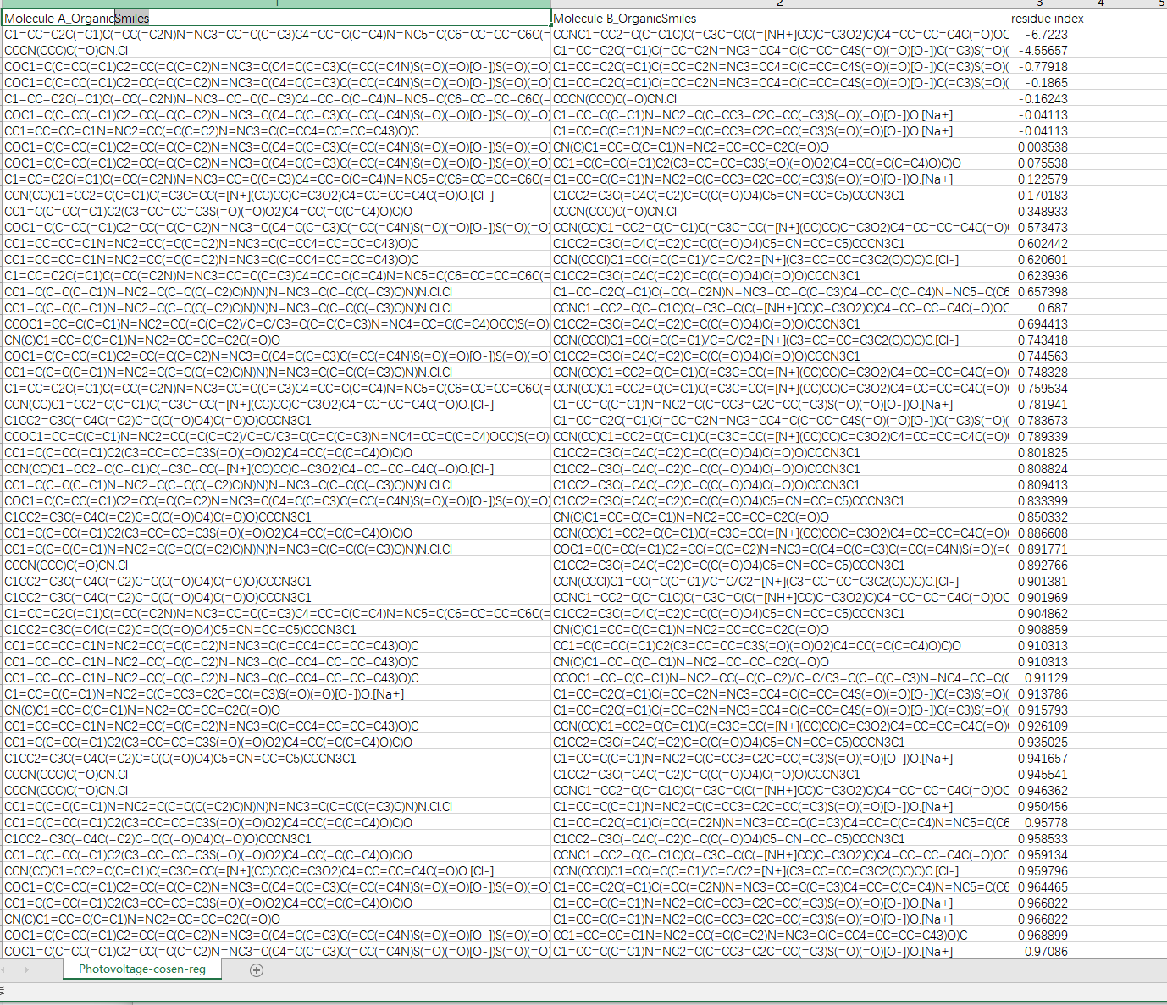
2.2 Button for feature generation: organic Smlies
Button (Organic multiple column Smiles): Muti-column organic molecule Smiles→ RDKit descriptors
Descriptors: Organic Multiple column Smiles → Import → Featurize

Slide 13
CSV template for user
Dataset after featurization √
Dataset including Smiles or formula √
Attention！：
Column name ending with Smiles or Formula
Variable 1（molecule A）
Variable (molecule B)
Target:
Stability/
Efficiency, etc.

Slide 14
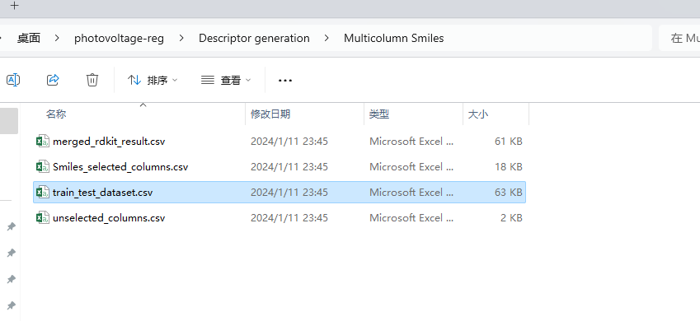
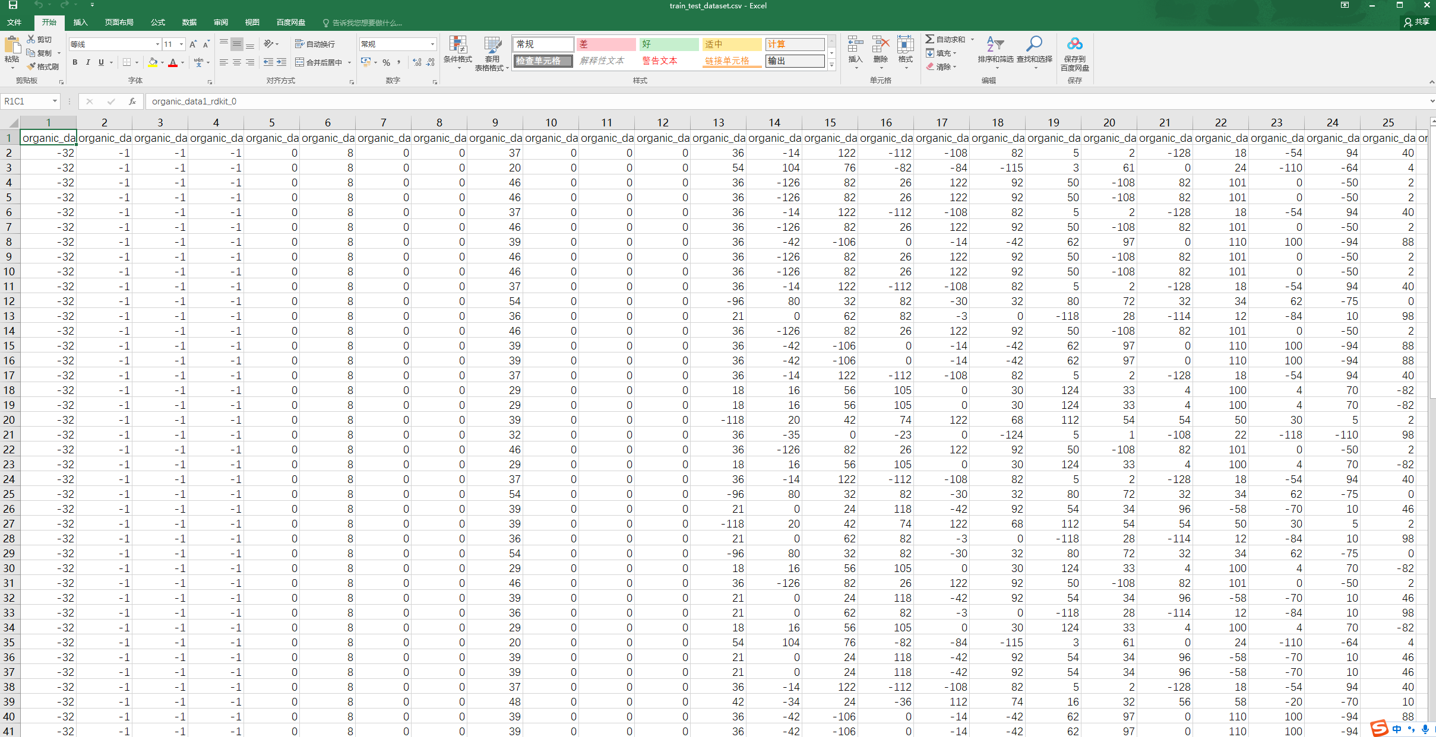
NJmatML: Feature generation (Inorganic)
Smiles: Featurization
Open train_test_dataset.csv
Test and train dataset
(For subsequent feature selection)

Slide 15
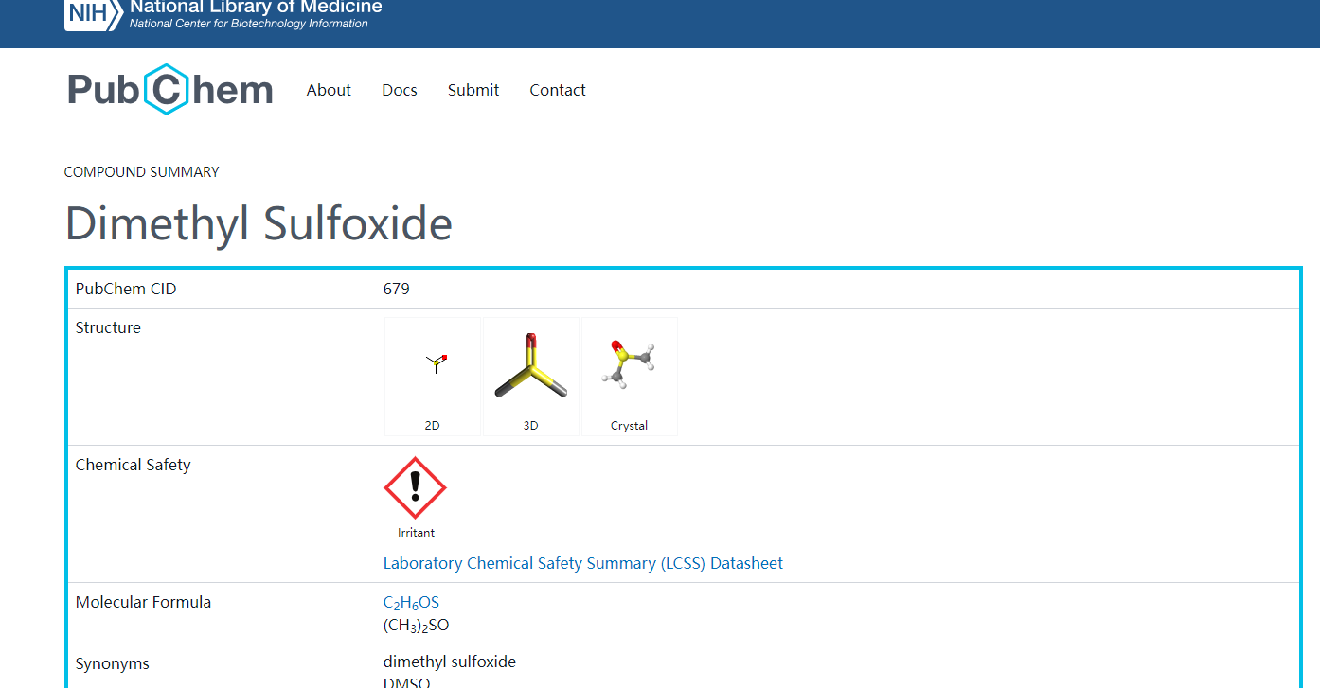
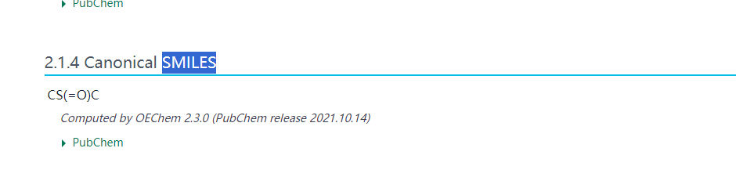
Smiles: can be consulted from websites (e.g.,Pubchem)
Pubchem

Slide 16
2.3Other button for featurization
推荐
Uniseriate Smiles → RDKit descriptors generation
Uniseriate Formula→ One hot of periodic table
Uniseriate Formula → magpie descriptors generation

Slide 17
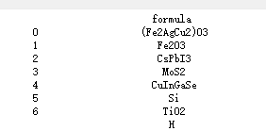
2.3Other button for featurization:one-hot
TiO₂:
O: 0.666666为O
Ti: 0.333333为Ti

Slide 18
3 Dataset import

Slide 19
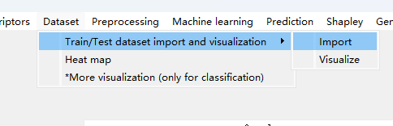
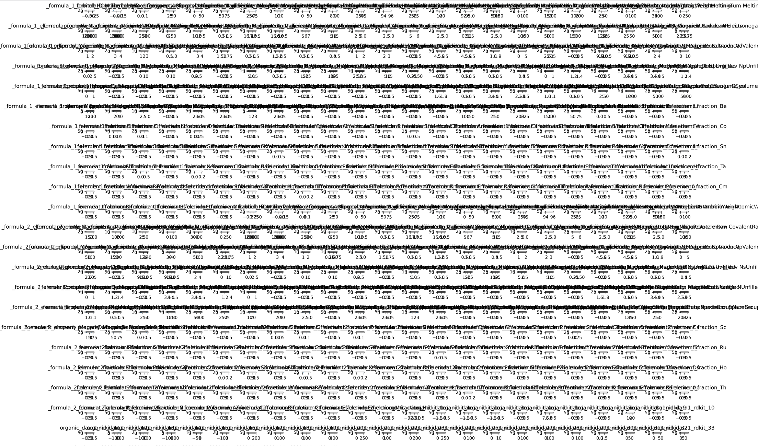
3.1Dataset import
Choose “train_test_dataset.csv”
For example：Custmo folders→Descriptor generation →Hybrid inorganic organic (2in1) → train_test_dataset.csv
Better：descriptor of domain knowledge（customized)
Data visualization
before feature selection

Slide 20
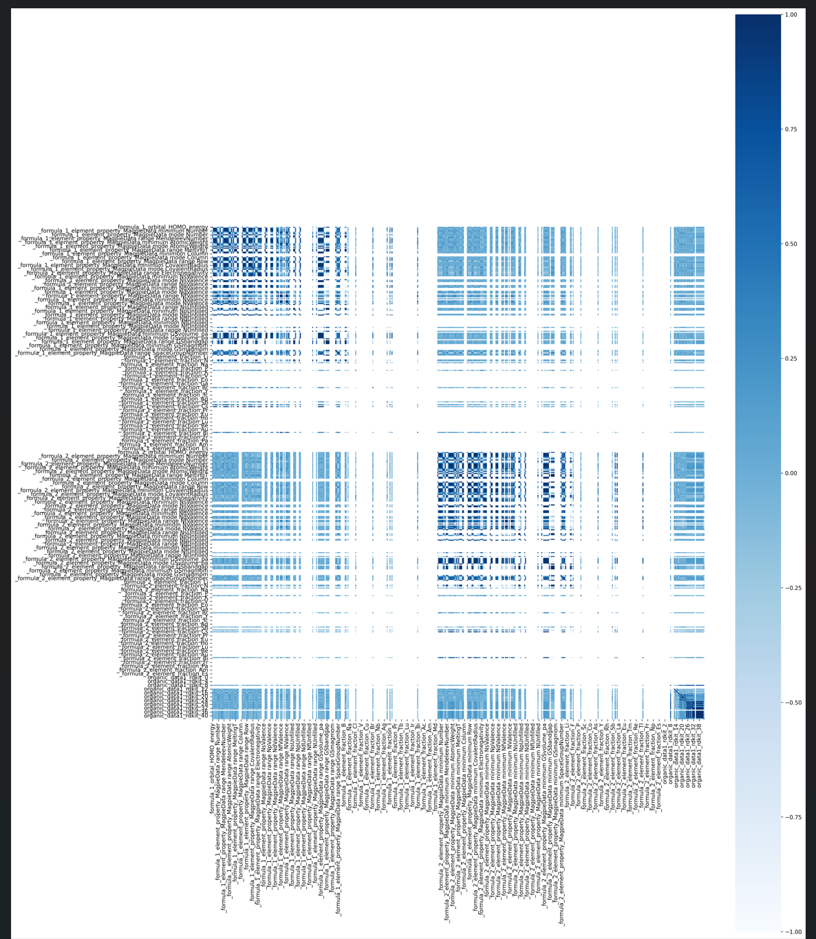
3.2Heatmap after data import
Heat Map

Slide 21
4 Preprocessing

Slide 22
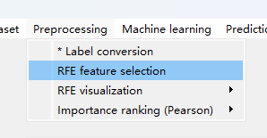
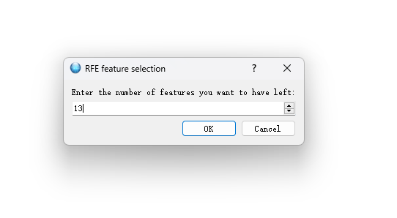
4.1 Preprocessing: RFE feature selection
Feature selection：RFE
Recursive feature elimination
Enter the number of features you want to keep
Such as 13

Slide 23
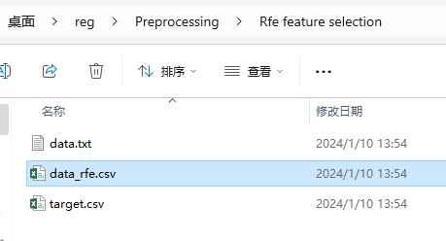
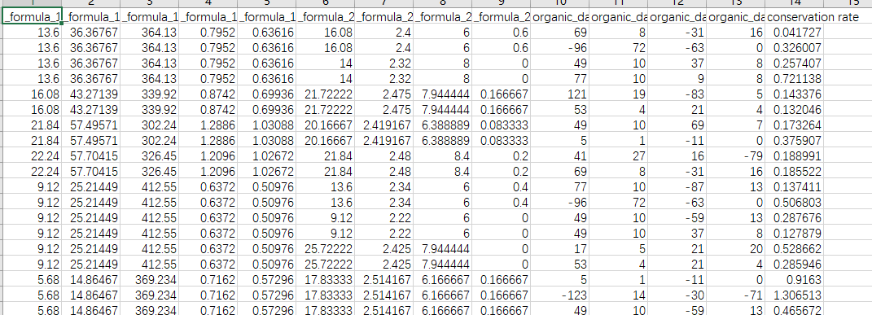
4.1 Preprocessing
Dataset after feature selection: data_rfe.csv：
Custom folder → Proprocessing →
Rfe feature selection → data_rfe.csv
The subsequent machine learning process base on this dataset
If you set 13 in the dialog box, the features in the automatically generated data_rfe.csv are 13 columns, and the left and right columns output data
Feature (input)
Target(output)

Slide 24
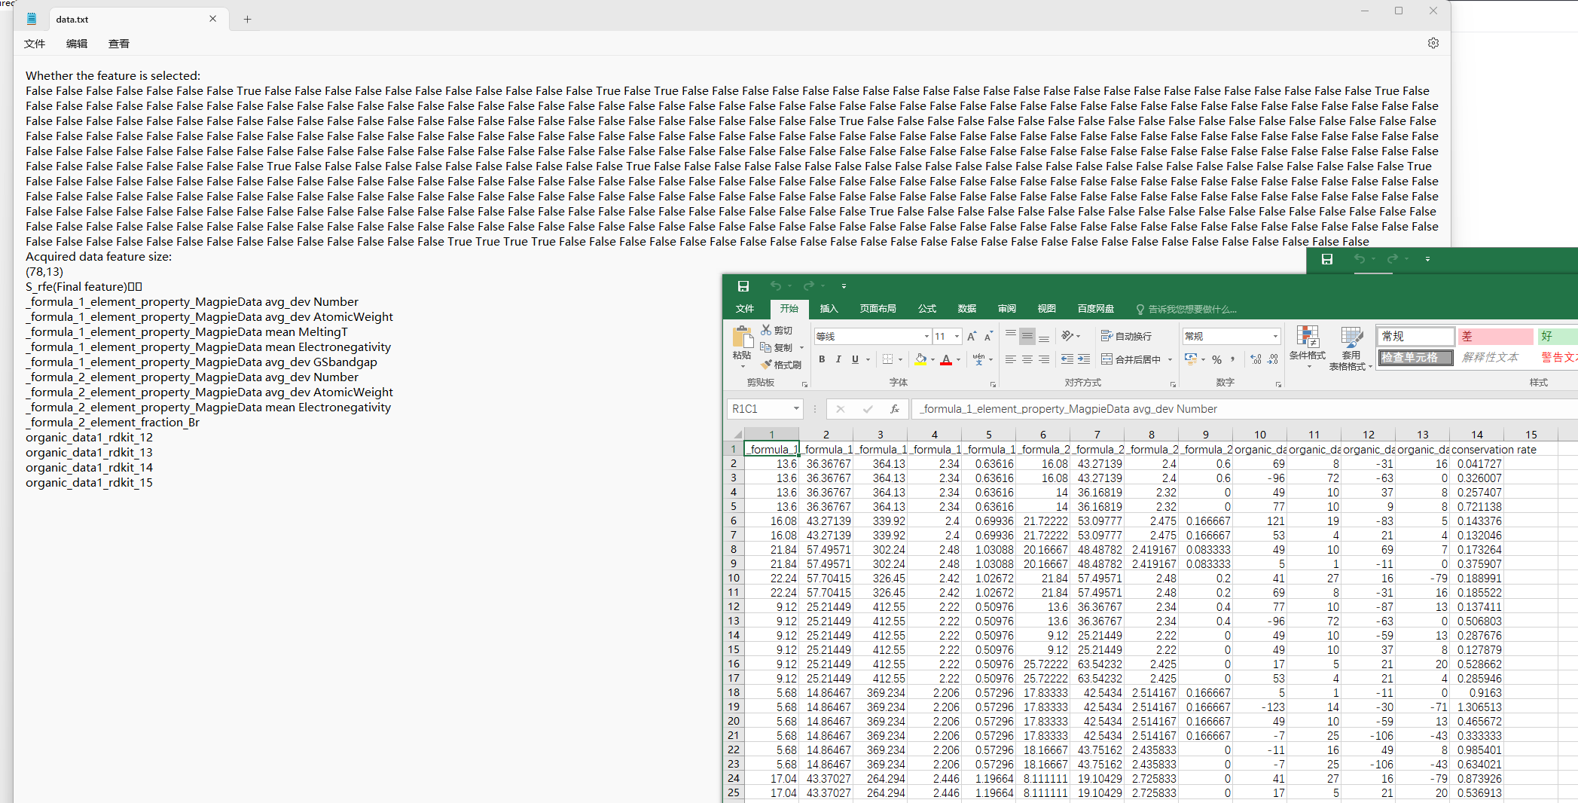
4.1 Preprocessing: Feature after feature selection
Dataset after feature selection: data_rfe.csv：

Slide 25
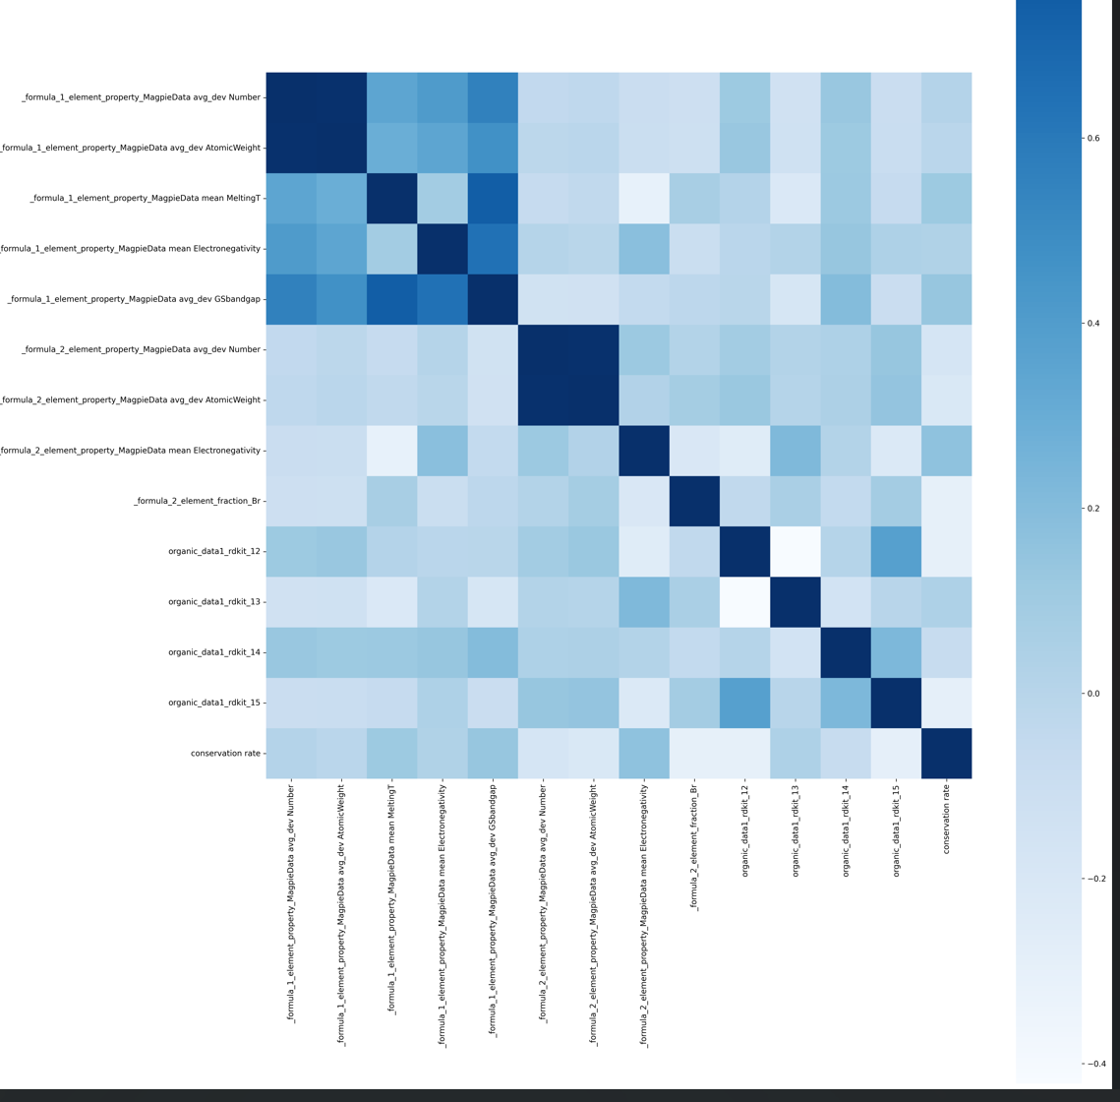
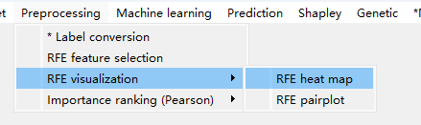
4.2 Preprocessing→Heatmap after feature selection

Slide 26
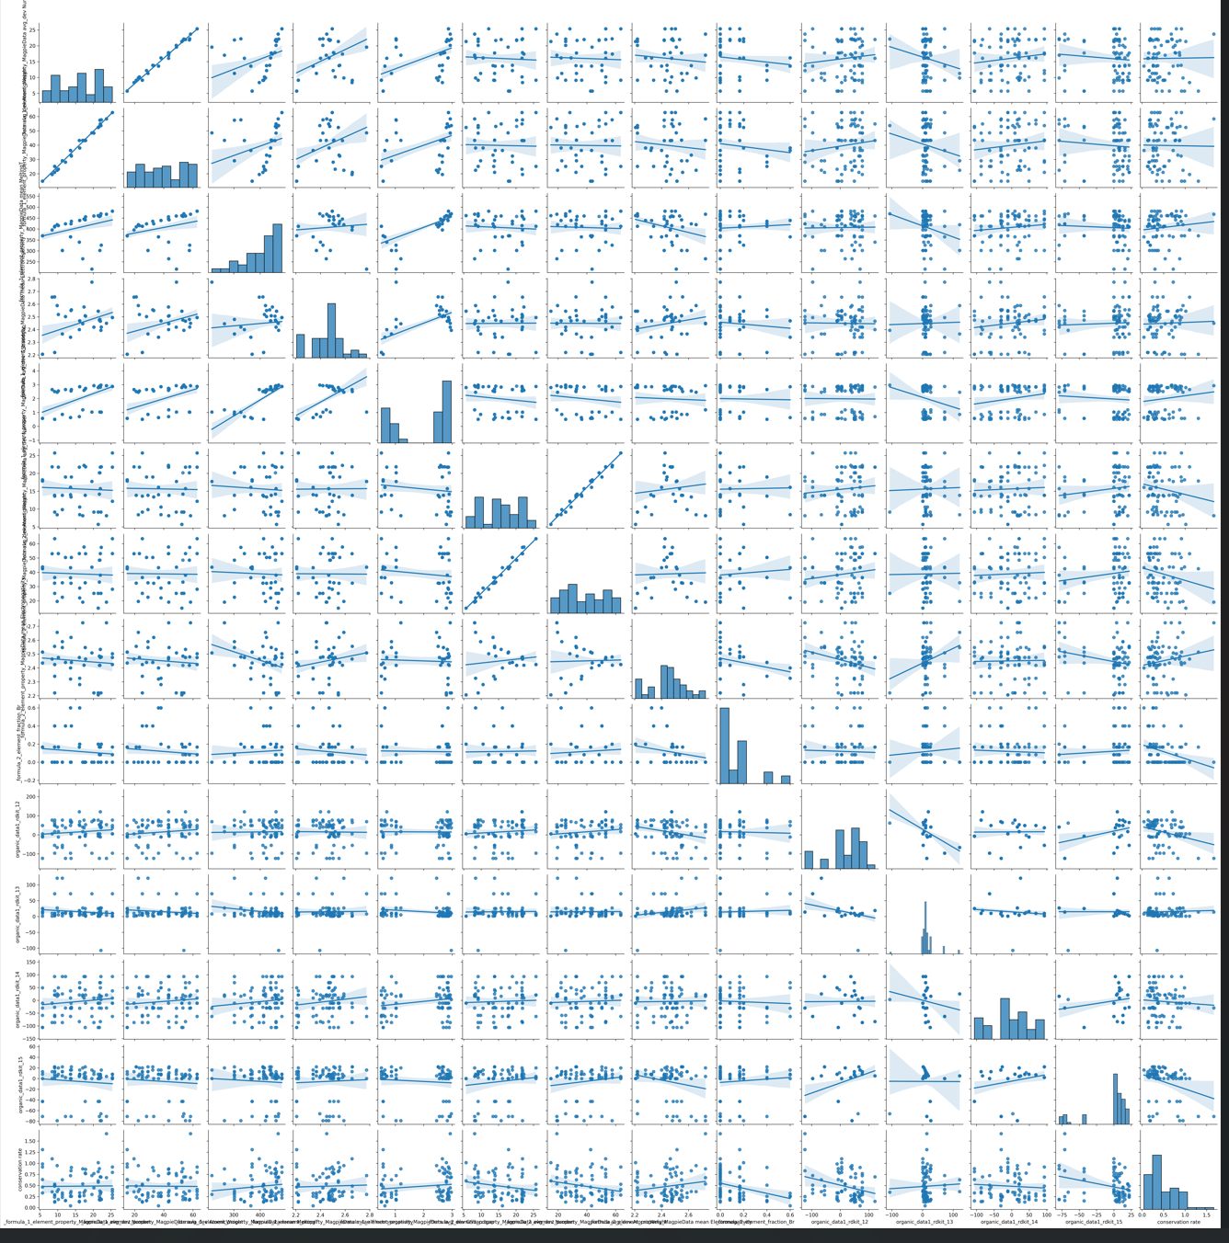
4.2 Preprocessing→pairplot after feature selection

Slide 27
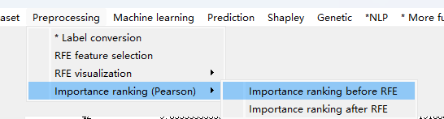
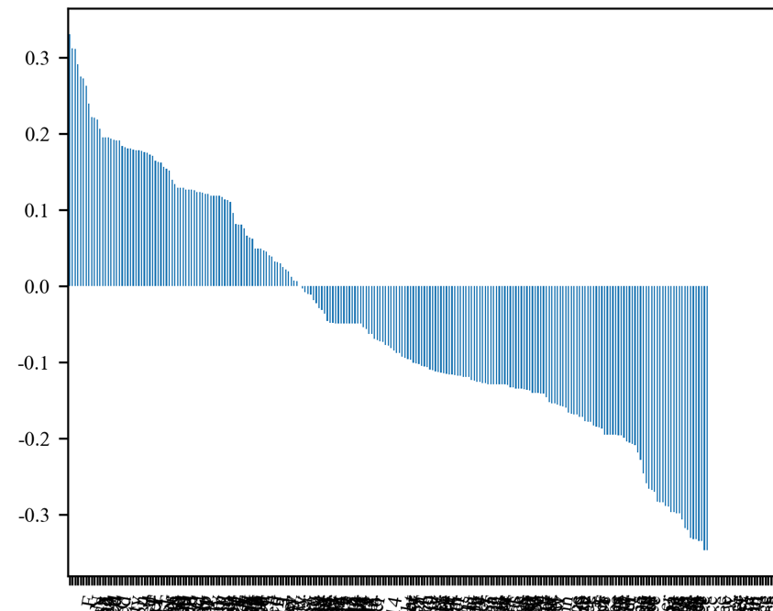
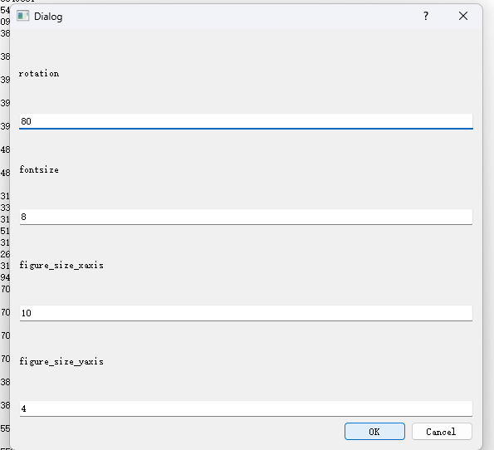
4.3.1 Preprocessing→Feature importance ranking before feature selection
Feature importance ranking（Pearson)
Shap is more convincing

Slide 28
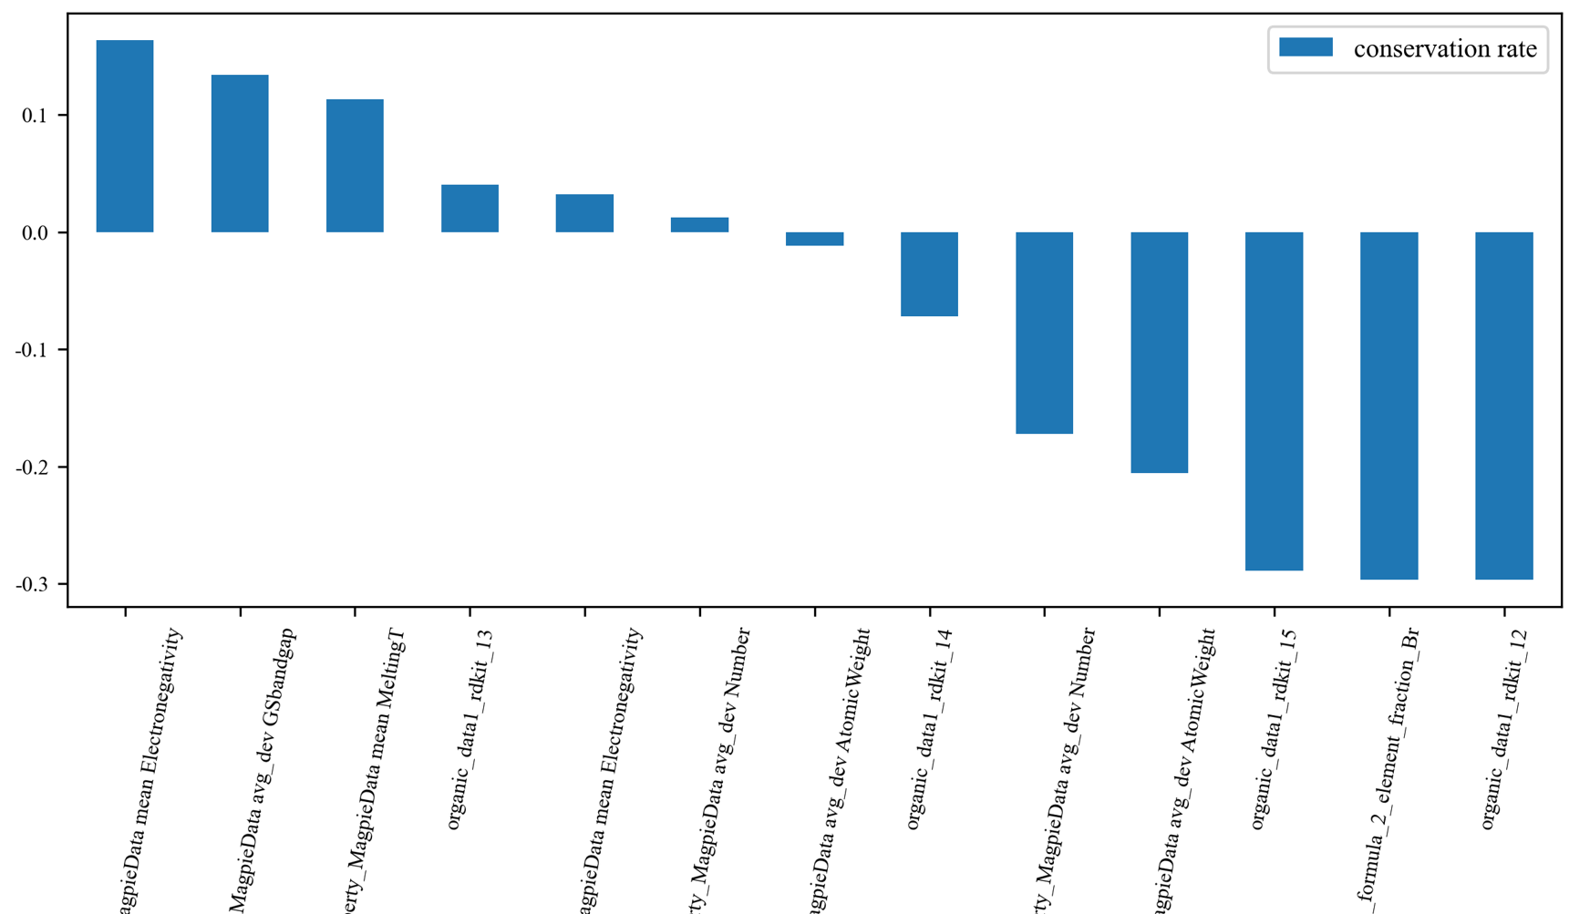
4.3.2 Preprocessing → Feature importance ranking after feature selection
Feature importance ranking after feature selection（Pearson)
Shap排名更被接受

Slide 29
5 Machine learning model construction

Slide 30
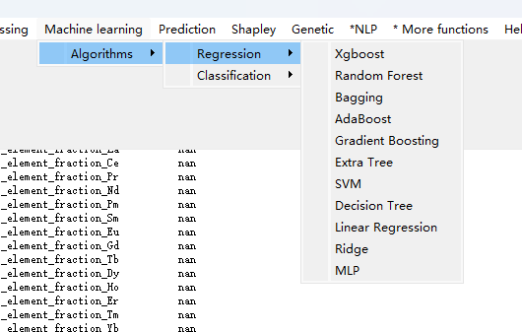
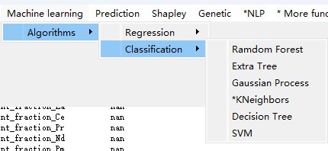
5.1 Machine learning model construction
Machine learning Regression task
Machine learning Classification task

Slide 31
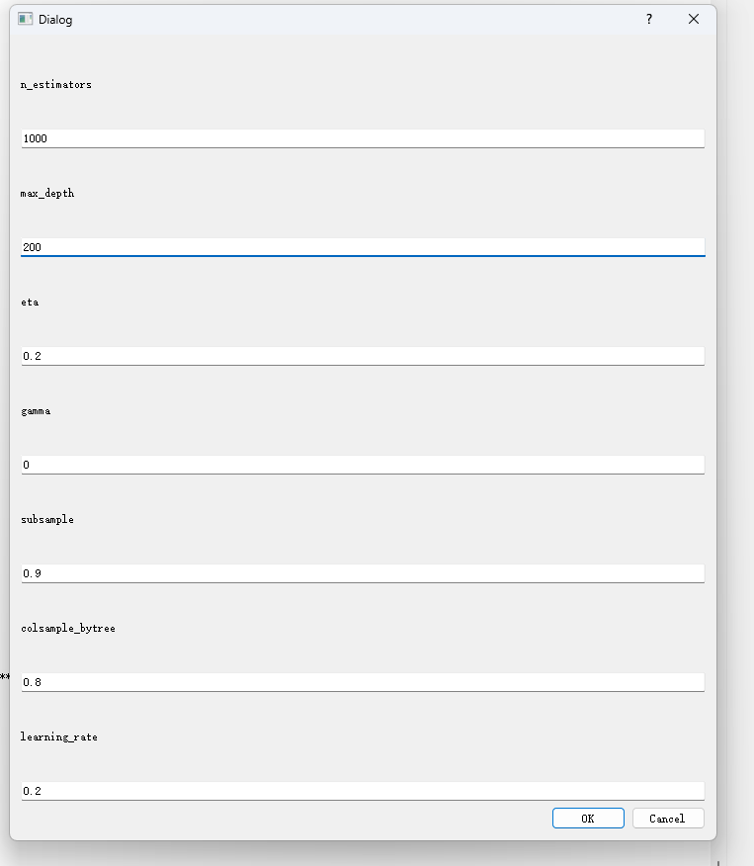
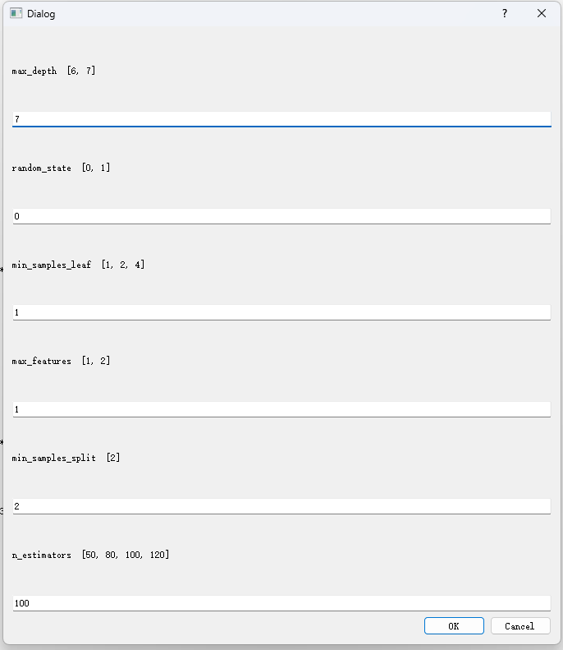
5.2 Machine learning: hyperparameters setting（independent dialog）
e.g. XGBoost hyperparameter，customizable
e.g. Random forest hyperparameter，customizable
All machine learning algorithm support hyperparameter customization

Slide 32
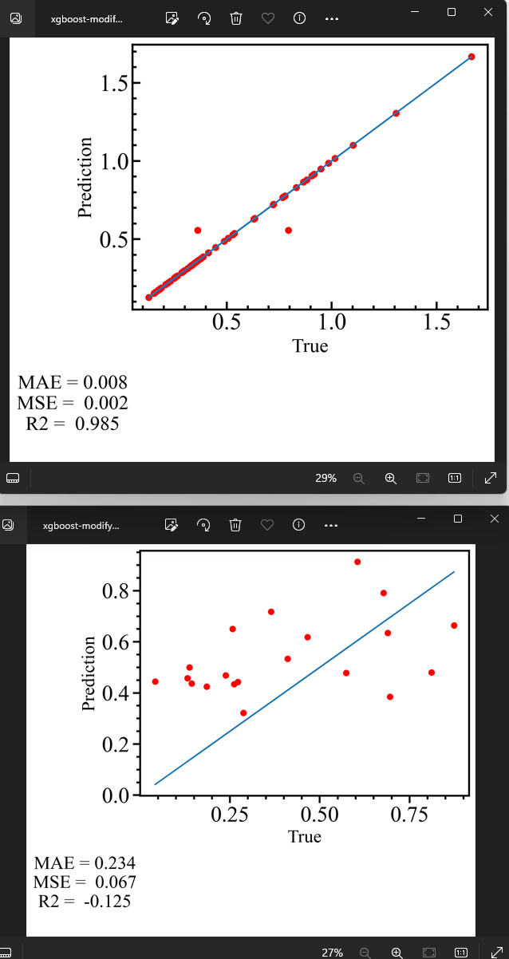

5.3 Machine learning : data fitting/accuracy/hyperparameter resetting
Test dataset
Default hyperparameters
Hyperparameter resetting:
Data fitting
Train dataset
To improve accuracy：
1. Customized descriptors
2. Machine learning（algorithm and
hyperparameter ）
Repeat the parameters
until the test set is accurate

Slide 33
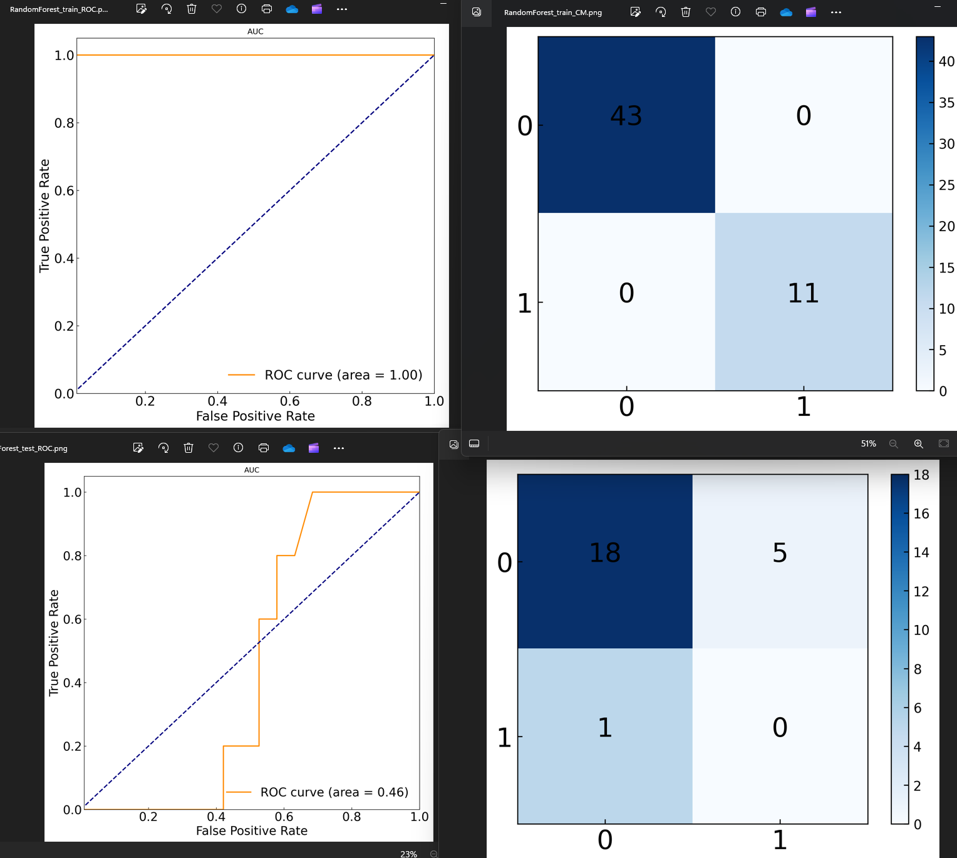
5.4 Machine learning classification task（e.g.,Stable or not）
ROC of train
dataset
Confusion matrix of train dataset
Repeat the parameters
until the test set is accurate
Again，To improve accuracy：
1. Customized descriptors
2. Machine learning（algorithm and
hyperparameter ）
ROC of teat
dataset
Confusion matrix of test dataset

Slide 34
6 Visual space prediction

Slide 35


Visual space predcition
If you need dataset featurization
Begin with import and generate
Following the process:
Prediction→ Import and generate (same as before) →
Import →Generate →Import virtual data（without label) →
Select machine learning model → Prediction generation (with label)
If you has an featured prediction dataset
Following the process:
Prediction→Import virtual data（without label) → Select machine learning model → Prediction generation (with label)
Attention!
Align the prediction set with the training test set The last column should be empty
The last column must have a list name

Slide 36

Visual space prediction
Import virtual data（without label)
Virtual_generate_final.csv

Slide 37

Visual space prediction
Prediction → Import virtual data（without label) → Select machine learning model →
Prediction generation (with label)
Target output（stability/effiency）
To be verified by experiments!

Slide 38
7 Shap feature analysis

Slide 39




Shap feature analysis
Clicking button “result”: Shapley figures automatically generated
Choose your machine learning model.dat
Data import: Data_rfe.csv

Slide 40
8 Genetic algorithm (symbolic regression/symbolic classfication)

Slide 41


Genetic:Mutation
Hoist Mutation
Point Mutation
Crossover
Subtree mutation

Slide 42



Genetic model constructon：导入csv数据集
e.g., Data_rfe.csv
Button of symbolic regression and
symbolic classification
Choose dataset after feature selection，e.g., data_rfe.csv
Genetic model constructing（default hyperparameter）

Slide 43

Genetic model construction：Figure generatuon
If it is not automatically opened, view the path of the graph: Customize the save path→ GP→Symbolic regression

Slide 44





Genetic model construction：Symbolic Tree
Explainability!
Science!
White box

Slide 45
To be continued (Other software functions NLP/Featurizer/Algorithms/DFT/SLME/CSP/Linux, etc.）

Slide 46


Acknowledgement and Conclusions
Small data problems in material design are still serious (regardless of simulation and experimentation: high cost, underfitting, overfitting)
There are pros and cons to various data sources and algorithms
Natural language processing (NLP) facilitates materials prediction
Genetic programming help with scientific explanations（formula/decouple)
Muti-modeling based on textual descriptors: Balance among accuracy/cost/explainability
Njmat software development (descriptors and algorithms)

Slide 47
Thanks !

